Slide 1
Command Line Interface Basics
Lab 01 - CS F111 (Computer Programming)

Slide 2
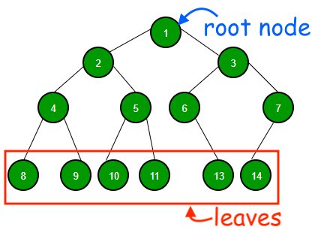
Preliminary: Directory trees
Let’s explore a new, more formal way of thinking about how your computer stores files in folders (directories). To visualise this, we use a special kind of graph called a tree.
A tree is made up of labelled points called nodes or vertices (shown in green in the figure at the left) and lines connecting some of them, called edges.
A tree has a single uppermost vertex called its root node.
The root node is connected to one or more nodes in the level immediately below it, called its children.
Each of these children may have its own children.
These children may also have their own children, and so on…!
Nodes without children are called leaf nodes or leaves.
Image courtesy: https://www.geeksforgeeks.org/binary-tree-data-structure/

Slide 3
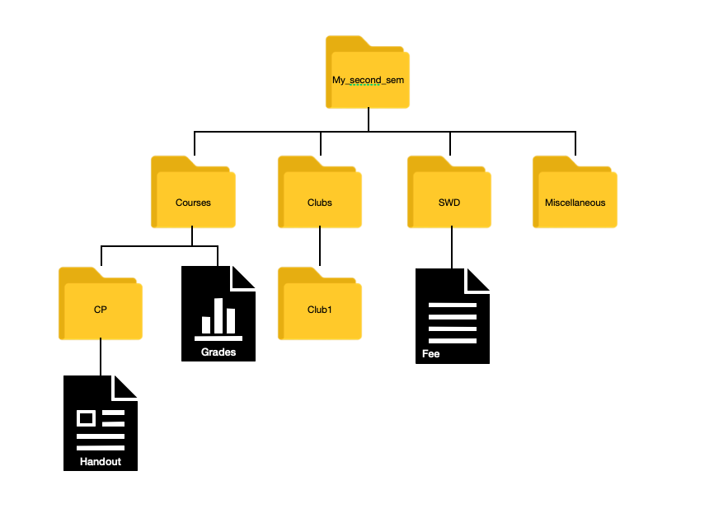
Preliminary: Directory trees
Now imagine a tree where every node represents a directory (folder) or file on your disk, and every child of a directory is contained in it.
This kind of a tree is called a directory tree.
The root node of this tree is called the root directory.
What do you observe?

Slide 4
What do you observe?

Slide 5
Preliminary: Directory trees
Every directory or file except the root directory has a unique parent
But not every directory has a unique child
Every file is a leaf node
But not every leaf node is a file!
Most importantly, for every file or directory there is a unique path starting from the root directory and ending at it.

Slide 6
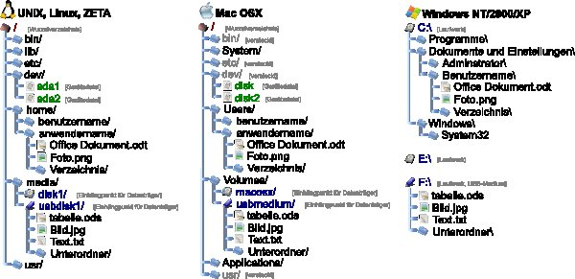
Preliminary: Filepaths
This unique path starting at the root node and ending at the file/directory is called its absolute filepath.
The root directory is common for all files on your disk, and its name depends on the operating system.
The absolute filepath is then expressed in the form
root/directory1/directory2/…/filename
You might have come across these on your computer in the form C:\Users\Person1\ilovecp.txt
The root directory for Windows is in the form drive:\ but for Linux it is simply /

Slide 7
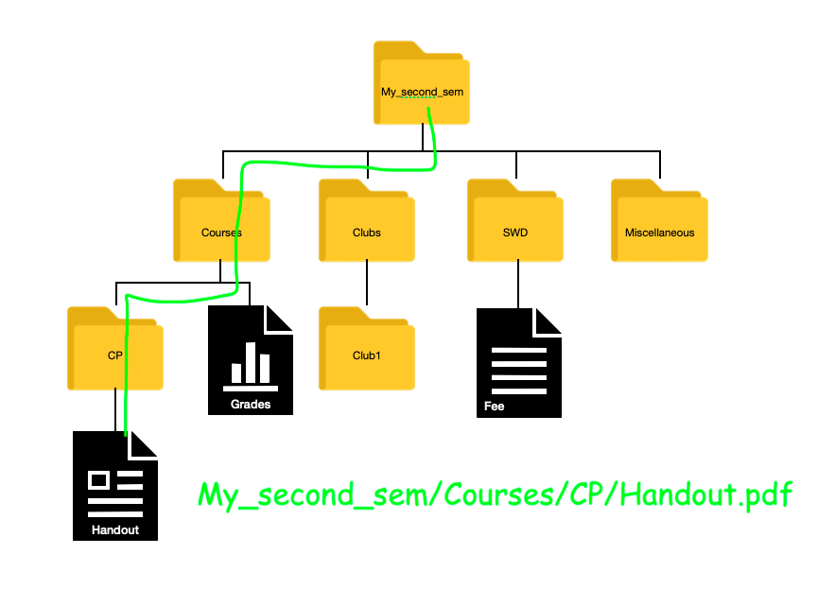
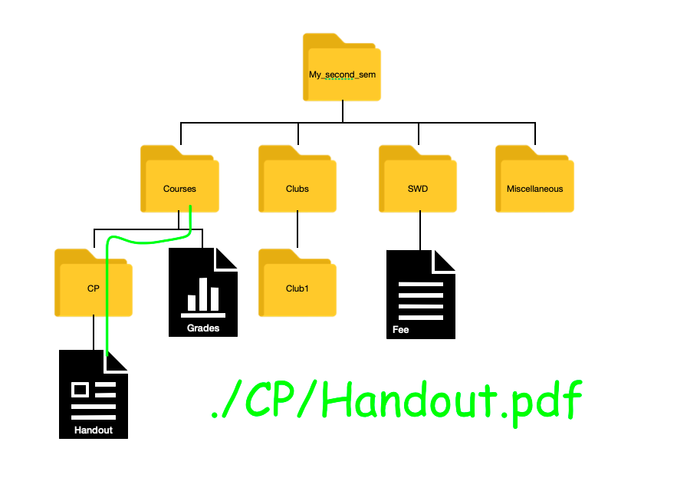
Preliminary: Filepaths
But sometimes when you are already in a directory, you might want the path from the current directory to the file you are looking for. This is called the relative filepath of the file to the current directory.
Absolute filepath of Handout.pdf
Relative filepath of Handout.pdf to Courses
Why the period?

Slide 8
Preliminary: . .. and ~
In a filepath, a single period (.) refers to the current directory. For example, when you are in Courses, . refers to Courses, ./CP refers to its child CP, ./CP/Handout.pdf refers to CP’s child Handout.pdf, and so on.
A double period (..) refers to the parent directory of the current directory. For example, when your current directory is Courses, .. refers to My_second_sem, ../Clubs refers to My_second_sem/Clubs, and so on.
A tilde (~) refers to the user’s home directory.
In Linux, the root directory is given by /

Slide 9
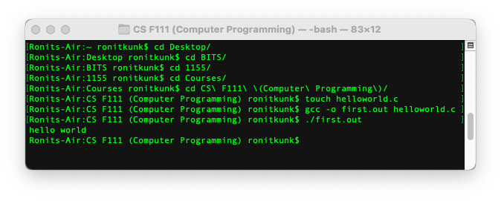
Terminal, Shell and Kernel
A terminal application (or console) is a programme you use to interact with your computer using a text-based interface.
This is done using text-based inputs called command lines that achieve some specific task.
An active terminal running on a computer

Slide 10
Terminal, Shell and Kernel
The terminal itself does not know what to do with the command lines you enter!
It passes them to another programme called a shell, which ‘translates’ these command lines into a form that can be understood by yet another programme called the kernel.
The kernel then works closely with your computer’s hardware to perform the specific task specified by the command line.
For this session you only need to be concerned with the terminal.

Slide 11
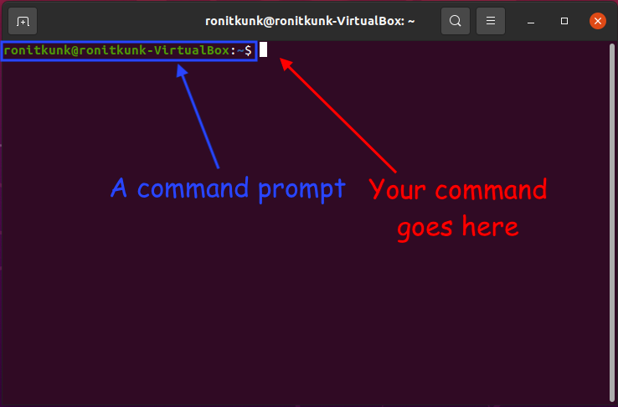
The structure of a command line
When you first open a new terminal, it gives you a command prompt, a piece of text usually ending with a $, > or % (depending on your shell) that indicates it is ready to accept a new command line. A prompt is also given after every subsequent command line is executed.
Recall that a tilde (~) refers to the logged in user’s home directory. The tilde in the image below shows that your home directory is the current directory (working directory).

Slide 12
The structure of a command line
Every command line follows a standard structure.
$ command --flag1 --flag2 . . . -opt1 optarg -opt optarg . . . arg1 arg2 . . .
A command specifies the broad task you want to do.
flags and options are used to modify the behaviour of the command.
flags are preceded by a double hyphen --
options are preceded by a single hyphen - and sometimes take arguments (input values) that must be placed immediately after, separated by a space
An argument is an input taken by the command
To autocomplete the command line, use the Tab key.
To return to the start of the command line, use the Home key.

Slide 13
Let’s get started
For this course, we’ll be working in the terminal that’s included in VSCode.
No need to worry - this works just like the system terminal, but it directly opens in your working folder and saves the effort of having to navigate all the way to it through a series of commands.
To start, use VSCode ‘Open Folder…’ menu item to open the folder where you’ll be adding files.
Then, go to the Menu Bar > Terminal > Create New Terminal to open a new terminal.
You will be greeted with a command prompt.
Let’s get familiar with a few common terminal commands.

Slide 14
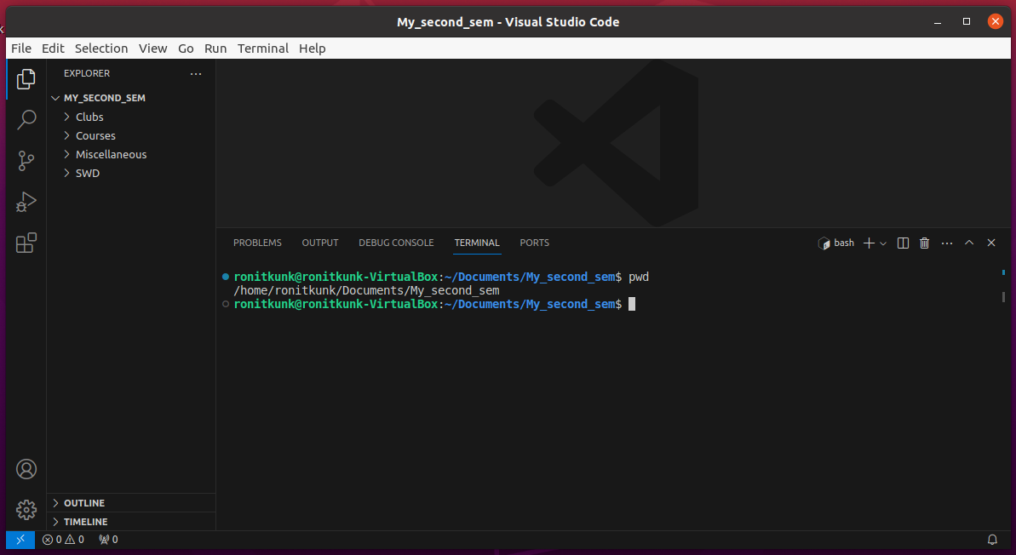
Commands: pwd
pwd (short for print working directory) prints the absolute file path to the current directory. For example, entering pwd immediately after opening My_second_sem in VSCode prints the absolute file path to My_second_sem on the terminal.

Slide 15

Commands: ls
The ls command lists all the items in the working directory.
The ls command can also be used to list the items in a directory other than the working directory. For this, you need to also provide the relative path of the other directory to the working directory as an argument (input) separated by a whitespace.
For example, the relative path of Courses to My_second sem is ./Courses. Using ls ./Courses, you can list the items in Courses while still being in My_second_sem!

Slide 16
Commands: cd
Sometimes, you might want to change the working directory itself. For this, you need to use the cd command. The argument is the relative path of the directory you want to change to. For example, here, we will change the directory from My_second_sem to Clubs.
Here the . refers to the current directory (My_second_sem).
What if you want to go ‘out’ of the working (current) directory? To do this, you need to go to the parent directory of the working directory. Recall that a double period .. refers to the parent directory.

Slide 17
Commands: mkdir
To make a new directory inside the working directory, use the mkdir (make directory) command. The argument is the name of the new directory.
There is a problem: When there is a space in the name of the directory, the two words separated by the space are read as separate arguments.
To fix this, there are some alternatives:
Precede every space with a backslash \
OR
Enclose the name in double quotes

Slide 18
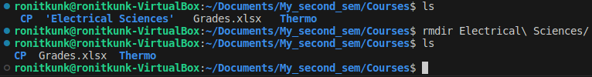
Commands: rmdir
The rmdir command (short for remove directory) is used to remove an empty directory from the working directory. The name of the directory to be removed is the argument.

Slide 19
Commands: touch, cat and rm
To make a new file inside the working directory, use the touch command. The argument is the name of the new file with its extension.
To view the file, use the cat command (short for concatenate) followed by the complete filename.
To remove the file, use the rm command (short for remove) followed by the complete filename. Be very careful while using rm!

Slide 20
Commands: chmod
chmod is a command that lets you change the permissions of a file or directory to all types of users.
Here’s the syntax of the chmod command:
chmod <Operations> <File/Directory Name>
You can grant or revoke the permission by replacing the Operations in the above command.
These operations need to be preceded with a '+' or '-' operator.
'+' indicates adding a new permission,
'-' indicates removing an existing permission.

Slide 21
Permissions
u – Grant permission to a user
g – Grant permission to a group (A Group of users)
o – Grant permission to others (who do not come under either of the above).
r – Grants read permission
w – Grant write permission
x – Grant execute permission
Here's an example: chmod +r sample.txt
The above command adds read permission for the sample.txt file.

Slide 22
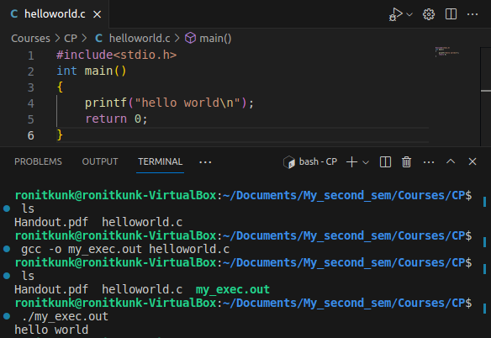
Commands: gcc
GCC, the GNU Compiler Collection, works together with a few other programs to compile the C source code file that you can understand into an executable file (Windows - .exe; Linux, macOS - .out) specific to your computer’s architecture.
The name of the executable file can be chosen by adding the option -o followed by a complete name for the file.
To run an executable, use ./ followed by its name (no spaces).

Slide 23
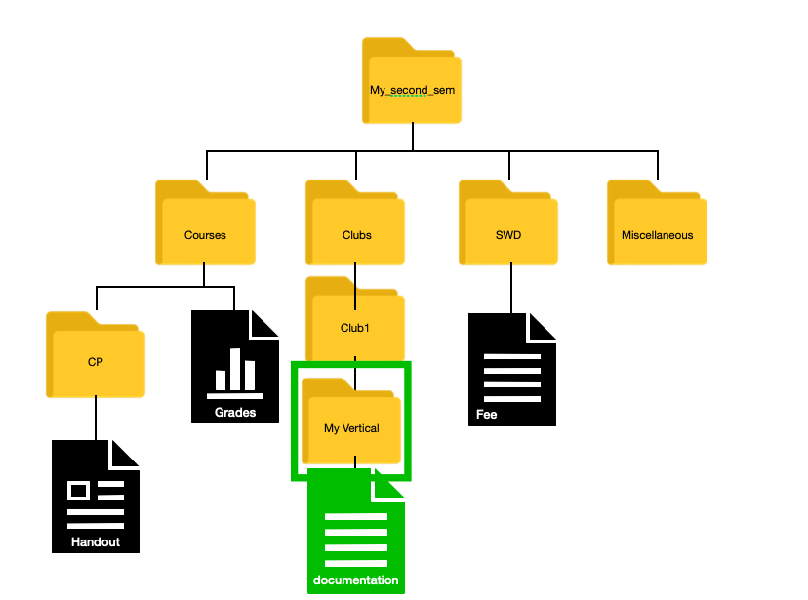
Practice exercise 😎
Without changing your working directory from CP:
create a new directory ‘My Vertical’ in Clubs
create a file in My Vertical called ‘documentation.txt’
mkdir ../../Clubs/Club1/My\ Vertical
OR
mkdir ../../Clubs/Club1/”My Vertical”
touch ../../Clubs/Club1/My\ Vertical/documentation.txt

